Slide 1




Notes:
Slide 1: Dove of peace stilling exercise
Use the stilling slide if desired: the suggested words should be spoken slowly, leaving pauses inbetween to create a sense of stillness.
As you sit quietly, watch the shape that’s being formed on your screen, little by little….[PAUSE]
Now practise slower breathing…..in…..and out…..in……and out…..keep this going as you continue to look at the flowers….[PAUSE]
You maybe notice that you are feeling more peaceful and relaxed….[PAUSE]
As you breathe, think back to all the people we’ve heard about this term and the challenges that they overcame….. [PAUSE]
We come into this special / sacred space and time to be still….to think deeply…..to be together as a school community…..
In our time together today, we will talk about a big question, share some words and then use them to help us to think.
But first, let’s welcome one another as we begin….

Slide 2

Leader: As we gather together today…
ALL: …we bring our thoughts and our hearts into this sacred space.
Notes:
Slide 3: Gathering
Leader: As we gather together today….
ALL: ….we bring our thoughts and our hearts into this sacred space.

Slide 3

What’s the message…?
Notes:
Slide 3: Looking at this image, I wonder what you think the message is? [talk together about your ideas]
Our world is not a place which is at peace – there are many places where there are wars and fighting – but there is always a place for hope that peace will come. Today we are particularly going to focus our thoughts on the situation in the Middle East, and give an opportunity to pray for peace in that region, but we know that there may be other parts of the world that are important to you, where we would also want peace [you may wish to name any that you know of impacting on your pupils or their families.] These places are not forgotten even though the news may be reporting about elsewhere!

Slide 4
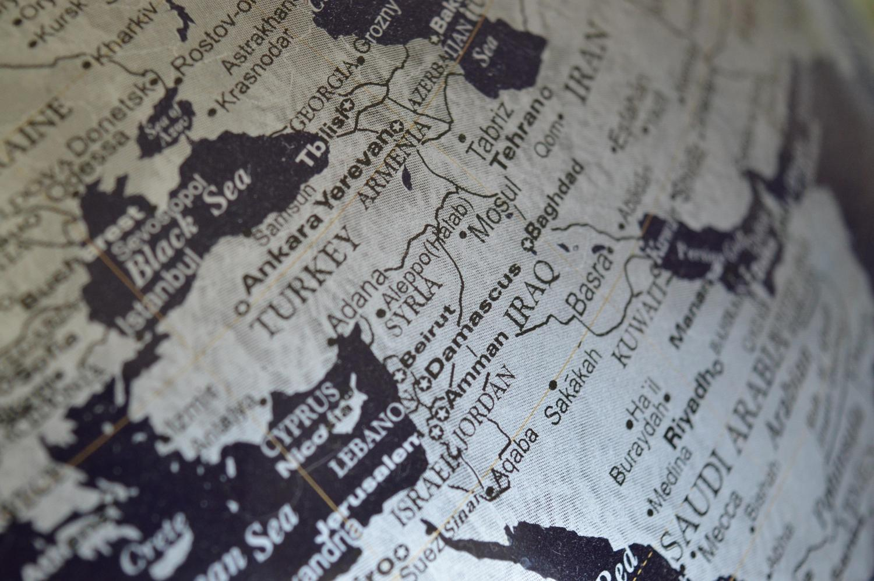
Notes:
Slide 4: The Middle East covers a huge area. You might be able to pick out some names for countries or cities you recognise….or places you might have heard about in the news.
What’s happening in the Middle East is difficult for us to understand, and we know that for some people who have family and friends who live in that part of the world, this is a very worrying time.
And so, today, we will also seek comfort from knowing that as part of a community / school family, we can stand with each other and support one another.

Slide 5
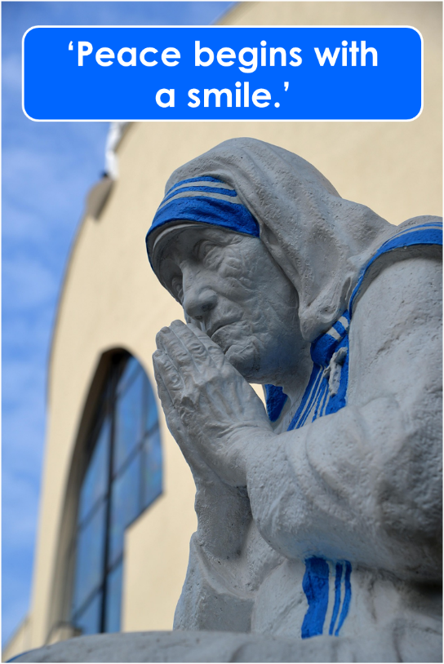
Being a peacemaker
Notes:
Slide 5: We’re going to start much closer to home – or rather to school!
I wonder how we deal with conflict / disagreement / arguing at school? [Talk especially about strategies that children suggest, and be prepared to suggest your own, focussing on how they manage their feelings and bring reconciliation]
These are all such great ideas and we really wish that all people across the world could listen to your ideas and model their peace-making on how you do it!
Whilst there is conflict – disagreement – in the world, we can still do something here, in our community, that means we learn how to build peace for ourselves for now – and for the future. Peace begins with us – as Mother Teresa once said ‘with a smile’. Peace-making is not about taking sides, because war hurts everyone, but about recognising that we are all human beings capable of reaching out to others, wherever they are from. A smile is a universal action that anyone understands – and it can be a powerful tool in peace-building!

Slide 6



Hear my words O Lord…
Consider my sighs…
Listen to my cry for help…
I called to you in my distress…
…and you answered me.
(Psalm 5:1-2; Psalm 118:5)
Adapted from an Engage Worship resource
Notes:
Slide 6: But as we look at what’s going on in our world, sometimes it’s hard to know quite what to say, or how to say it.
Christians will often turn to the words of King David’s Psalms to help them when it feels like they have no words of their own – and we’re going to do the same to help us. Listen to these words [each phrase animates separately. Read them out and if necessary, explain any unfamiliar words to children]
King David prayed words like these often: he lived through times of war and times of peace – and he knew from his own experience how God was with him, that God heard, God saw and God answered.
As we think about the situations we see – and the people who are caught up in the middle of them all – these words written by King David give us permission to express our concerns, and our desires for justice and peace, bringing them before God who hears, and answers.
Responding and words of worship: As we draw near to the end of this time together as a community, let’s just be quiet. As you sit with this stillness, maybe you’d like to reflect; to bring your own thoughts, hopes or dreams about peace into the quietness of this moment….. [leave pause]

Slide 7
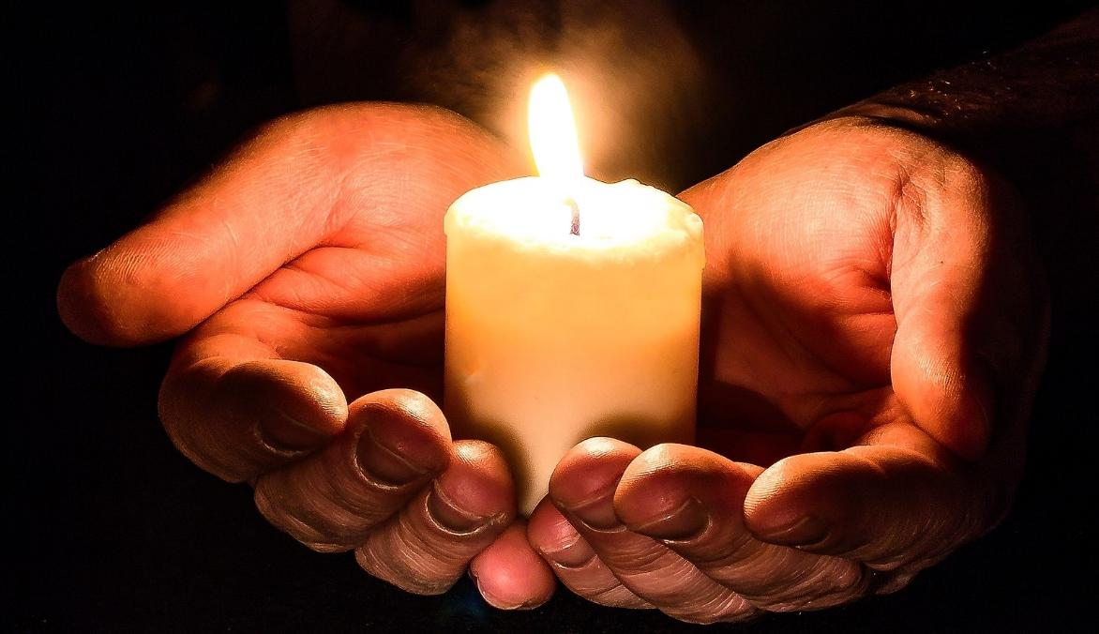
We call to you in our distress…
We trust you to answer us.
Adapted from an Engage Worship resource
Notes:
Slide 7: I’m going to use some of those words to help us to pray now; you can join me if you’d like to, or if praying is not something that you’re comfortable with, then hold your own thoughts in your head and heart.
The challenge of praying this prayer is that we may not always know that our prayers have been answered – but we can be sure that God hears what we pray. So, let’s pray with confidence and compassion….
When I say the words ‘We call to you in our distress’, you can join me with ‘We trust you to answer us.’

Slide 8
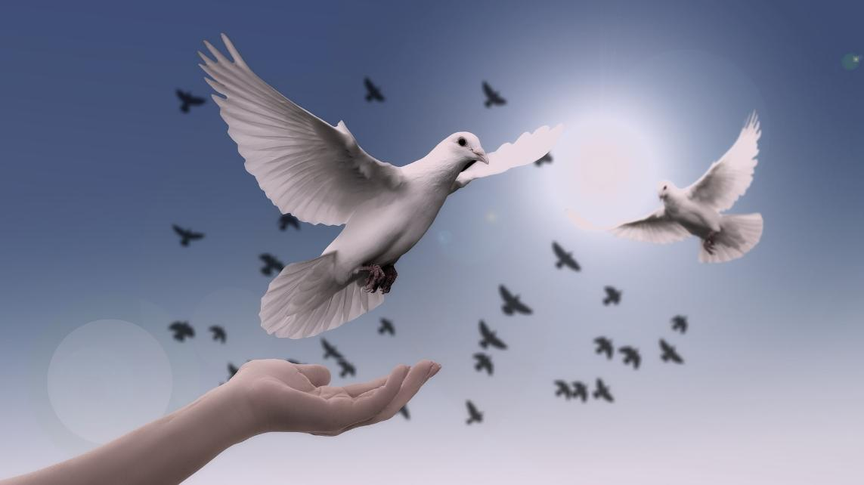
We call to you in our distress…
We trust you to answer us.
Adapted from an Engage Worship resource
Notes:
Slide 8: God who sees and hears,
We bring to you anyone who is living in the midst of conflict.
May you comfort them and bring peace to their homes and to their hearts.
‘We call to you in our distress’,
‘We trust you to answer us.’

Slide 9
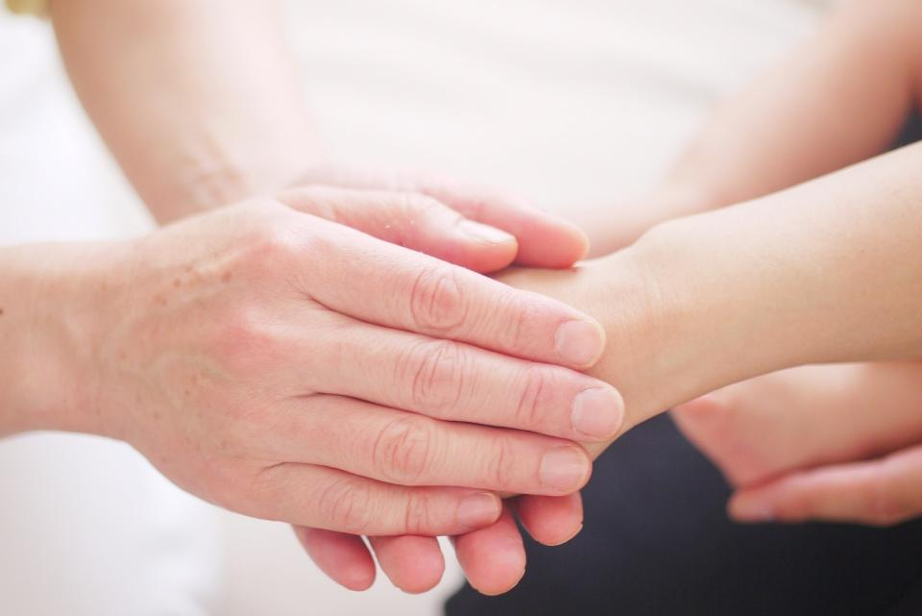
We call to you in our distress…
We trust you to answer us.
Adapted from an Engage Worship resource
Notes:
Slide 9: We pray for all those who are working for peace.
May you use their hands to bring healing and hope.
‘We call to you in our distress’,
‘We trust you to answer us.’

Slide 10
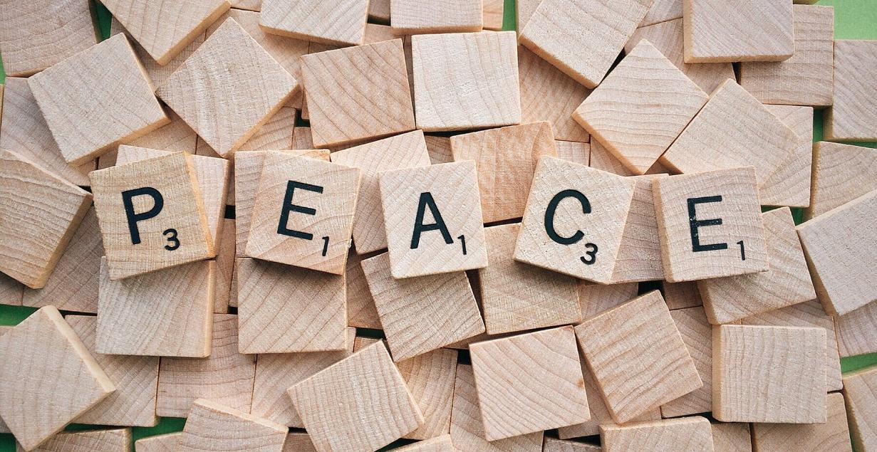
We call to you in our distress…
We trust you to answer us.
Adapted from an Engage Worship resource
Notes:
Slide 10: We pray for our world’s leaders;
Guide how they react to all that is happening.
May peace and hope triumph over fear and hate.
‘We call to you in our distress’,
‘We trust you to answer us.’

Slide 11
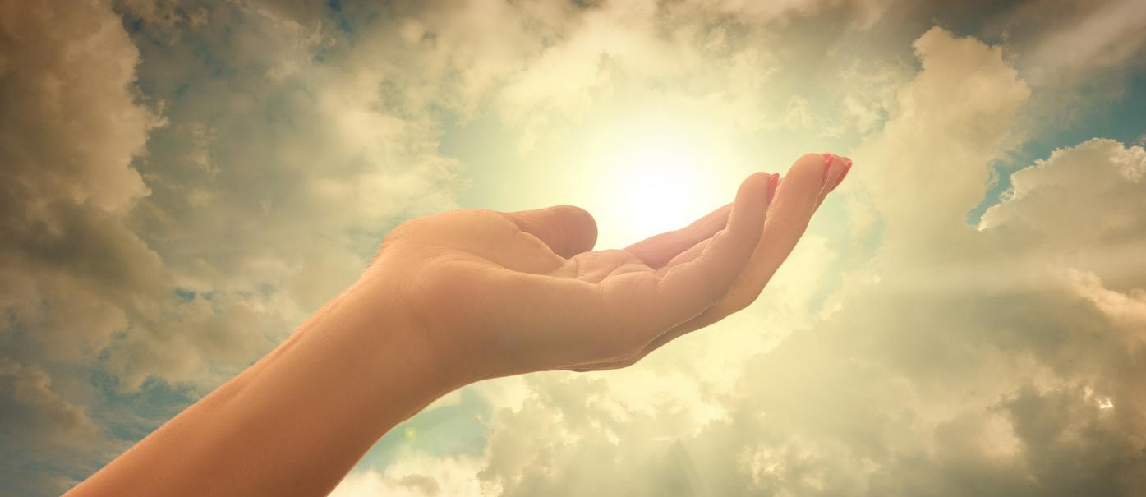
We call to you in our distress…
We trust you to answer us.
Adapted from an Engage Worship resource
Notes:
Slide 11: In a few moments of quiet, I invite you to bring your own worries, sadness and hopes to God now, if you would like to….. [leave pause here]
‘We call to you in our distress’,
‘We trust you to answer us.’

Slide 12
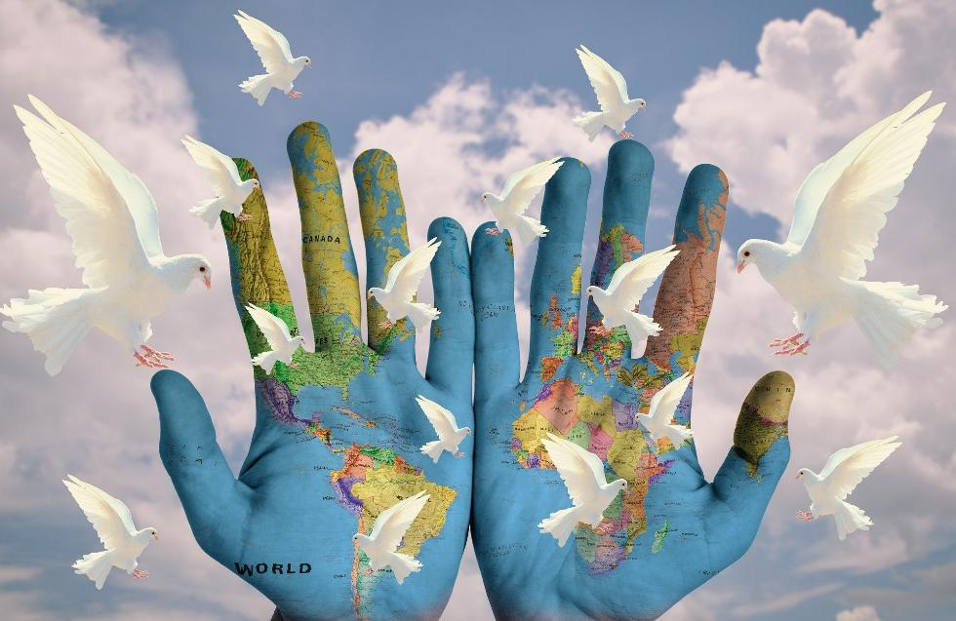
We call to you in our distress…
We trust you to answer us.
Adapted from an Engage Worship resource
Notes:
Slide 12:
God of peace and God of love
‘We call to you in our distress’,
‘We trust you to answer us.’

Slide 13
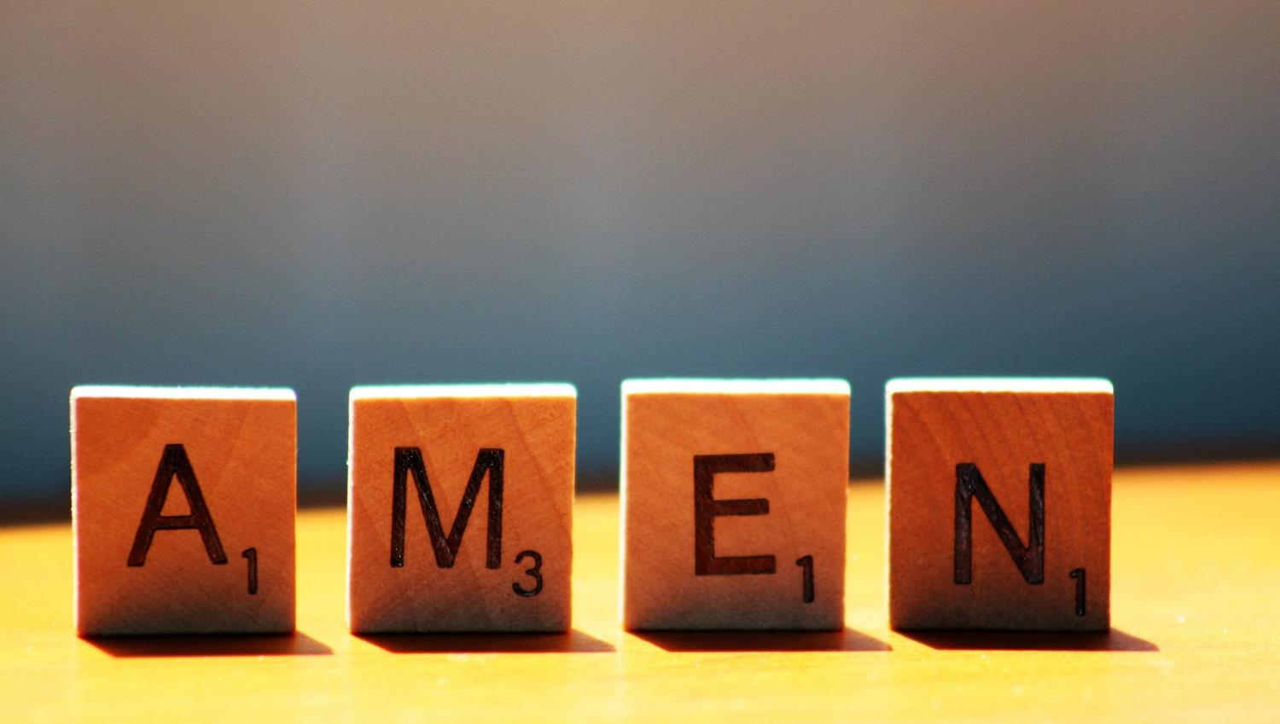

Slide 14
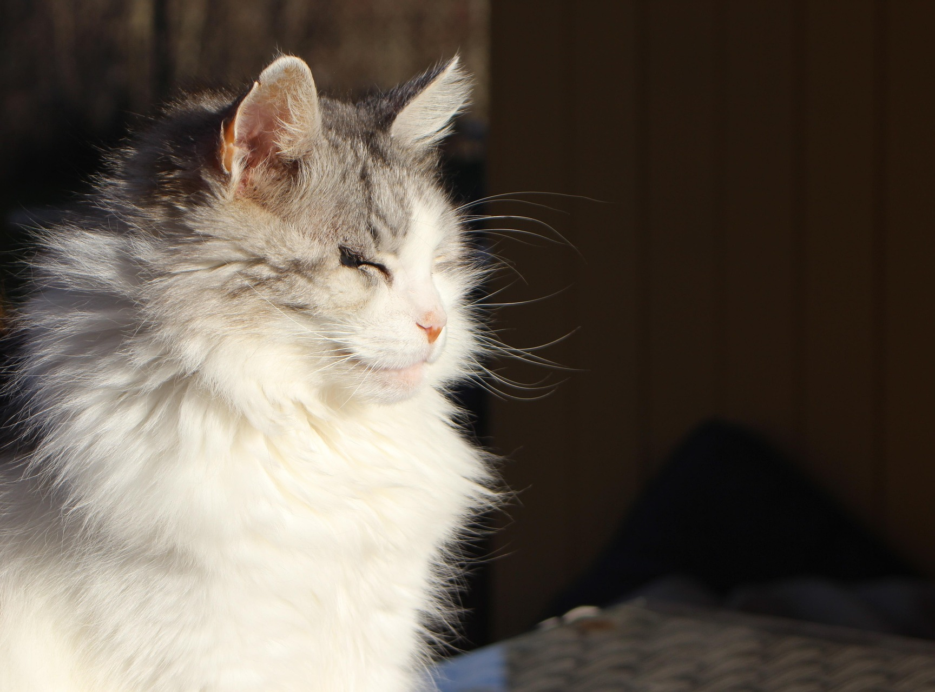
Peace begins with a smile.
Do your best to live in peace with everyone.
Romans 12:18
Notes:
Slide 14: I bet this image made you smile! Earlier, we were reminded about the power of a smile in the task of peace-building – here in our school, our wider community and our world. As we leave, I want to leave some more words with you. They’re words from the Bible that Paul wrote to his friends about peace: Do your best to live in peace with everyone. Let’s make this happen everywhere we go today!

Slide 15
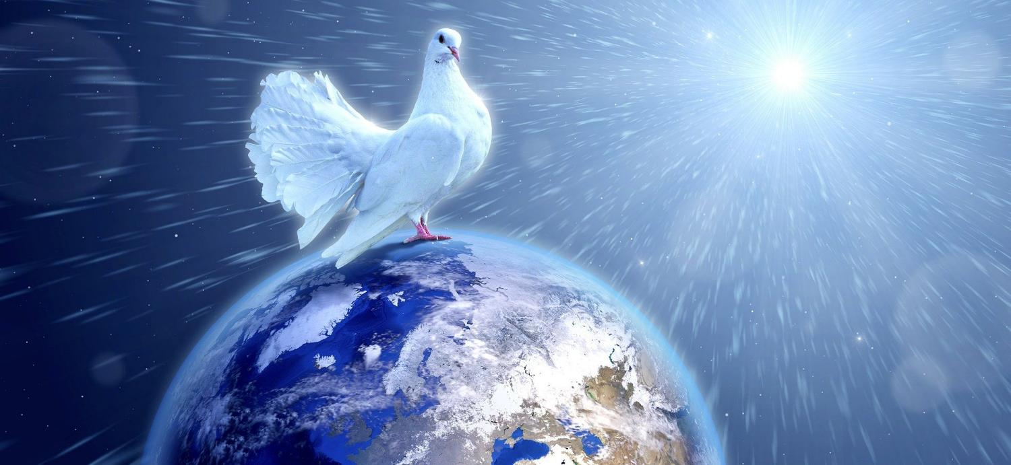


Leader: As we leave this place & time and go into the day ahead…
All: May we shine like stars – and live in peace!
Notes:
Slide 15: And so, as we end this special time of reflection, we will leave with our familiar words for this term….with Paul’s words at the end!
Leader: As we leave this place & time and go into the day ahead…
All: May we shine like stars! – and live in peace
[NB If you feel you need to, remind children of who they can talk to in school if they want to.]

Slide 16
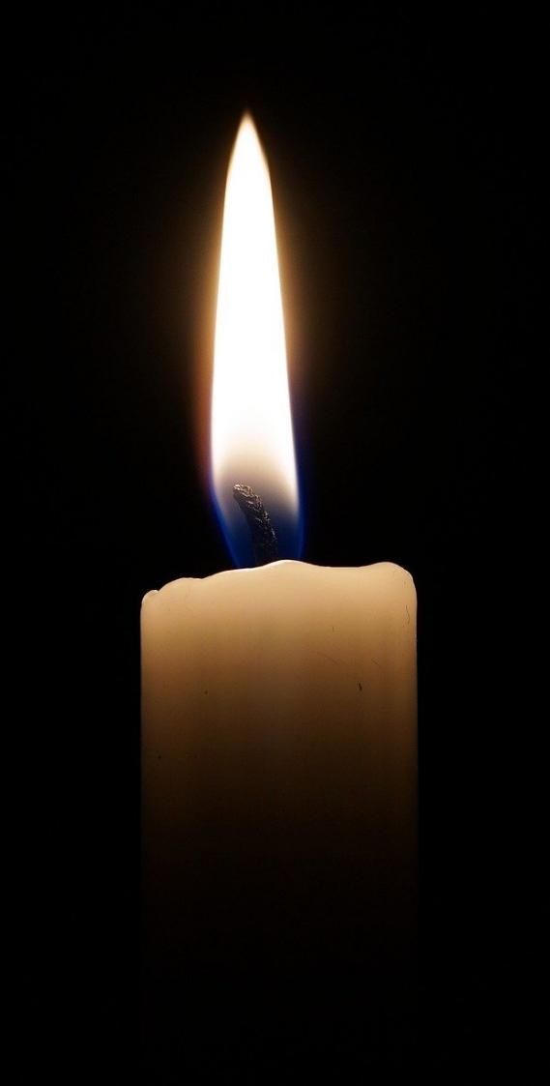
We light this candle for peace…
May its light scatter the darkness;
may its flame be a symbol of hope;
may its burning be a sign of faith joining with many other lights around your world, for peace.
Prayer by St. Paul’s Cathedral
Notes:
Slide 16: alternative prayer

